Slide 1
Discipline of Students With Special Needs
Urszula Markowska-Manista

Slide 2
DISCIPLINE?
What do I remember from my childhood (school) when it comes to discipline?
Are these associations positive
or negative?
Why? (reasons?)

Slide 3
DISCIPLINE
What is discipline?
Discipline remains the practice of teaching children how to follow the rules.
What discipline isn’t:
Punitive physical punishment to teach someone a lesson.
Verbal abuse about how despicable someone is.
Use of a stick or other form of physical abuse.
Refusing basic needs to people like eating or going to the bathroom.
The behavioral problems presented by these students often result from feelings of discouragement, frustration and inadequacy.
All classrooms need rules to function effectively. These “rules” are sometimes called “expectations” or “standards of behaviour.”

Slide 4
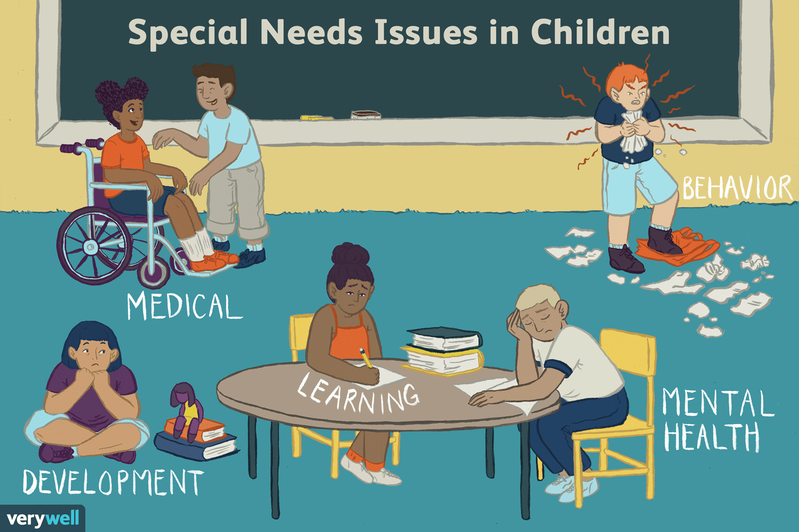

Slide 5
Discipline of Students
Reallity
of the classroom

Slide 6
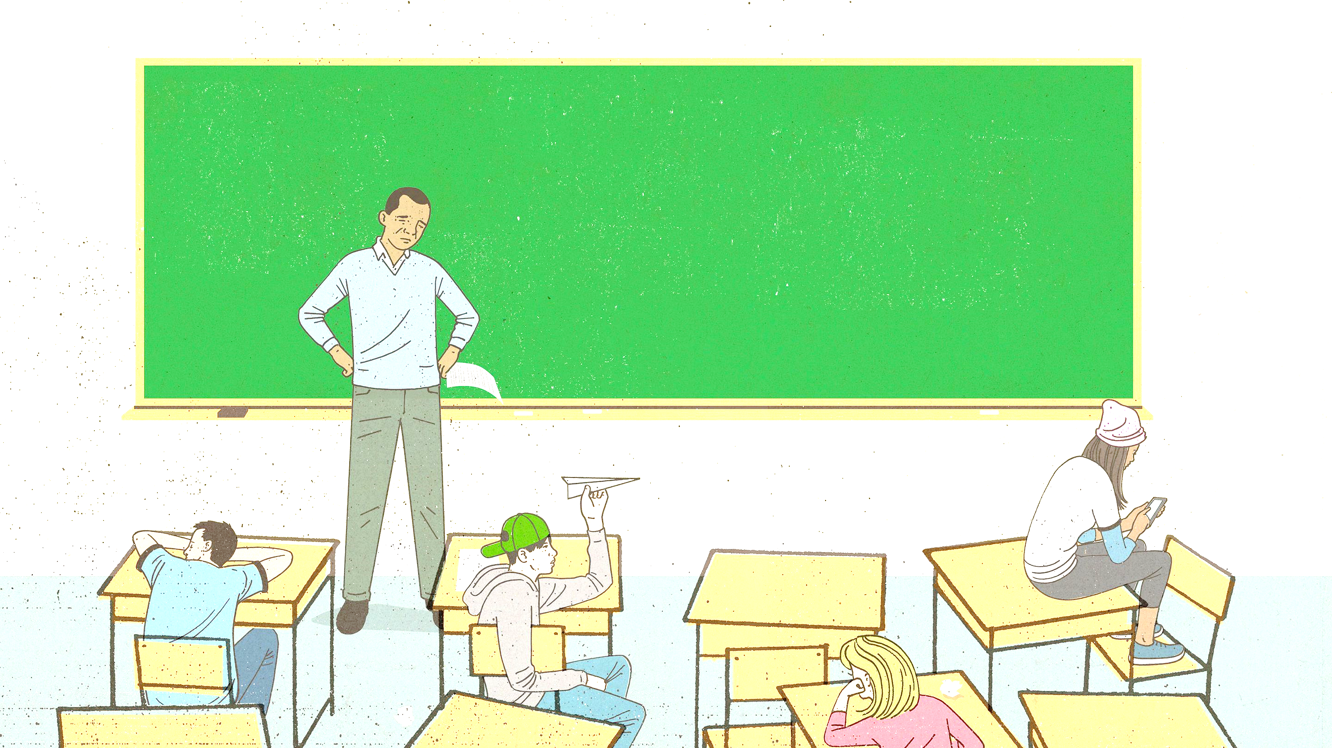
GOALS Understand the meanings of the behaviors,
Understand what might cause the behaviors to happen,
Understand how to respond to the behavior so the child can learn a better behavior.
Discipline of Students

Slide 7
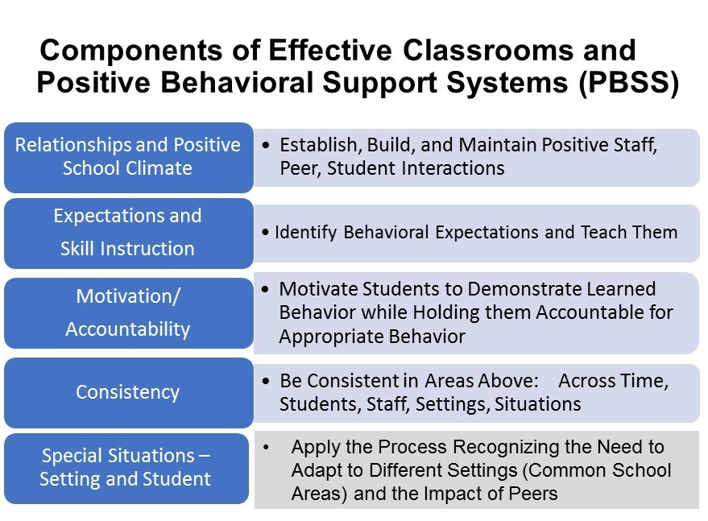

Slide 8
Classroom Management
Making the Learning Environment Comfortable Have you ever been in a crowded room, either crowded with many people or with many objects, like furniture?
How did you feel at first? After a while, did your feelings change?
Upon entering the room, many of us might have been initially surprised, but when we had to start actually working in the room and interacting with others, we may have begun to have negative feelings.
We may become frustrated or angry, or we may retreat to a corner and try to avoid others or avoid falling over or bumping into the many objects in the room.
In classrooms where the physical space is not managed well, our students may also have these same feelings.
They may misbehave as a reaction to their being frustrated or fearful.
A well-planned classroom space, therefore, can help us to prevent misbehaviours that might arise.
It also greatly affects what can be accomplished during a lesson.

Slide 9
Classroom Management
For many teachers, work with young people with SPE is associated with a kind of struggle
- a struggle for attention, appropriate behaviour or for students to fulfil their school responsibilities.

Slide 10
Here are some things to think about as you and your students organize your classroom space. This list is not exhaustive. Can you think of other items?
Seeing everyone.
You must be able to see all of your students at all times in order to monitor their work and behaviour.
You will also need to be able to see the door from your desk.
Your students must be able to see you and the area from which you are teaching without having to turn around or move a lot.
Adapted from: Classroom Management – Managing Physical Space. Collaborative for Excellence in Teacher Education (CETP), National Science Foundation. http://www.temple.edu/CETP/temple_teach/cm-space.html

Slide 11
Here are some things to think about as you and your students organize your classroom space.
Seating everyone (avoiding the feeling of being crowded).
In classes with many students, space is often a luxury. To make the best use of what space is available, consider trying three main strategies. First, remove unnecessary furniture.
Use mats instead of desks. Use shelving fixed on walls and off of the floor for materials that students do not need to reach for regularly.
If your classroom has a cabinet to hold students’ belongings, place it just outside the door of the classroom. If possible, keep your belongings, lesson materials, and any other items that you do not use during class time in the teacher’s lounge or in another safe place outside of the classroom. If you really don’t need a large teacher’s desk, ask for a small one.
Adapted from: Classroom Management – Managing Physical Space. Collaborative for Excellence in Teacher Education (CETP), National Science Foundation. http://www.temple.edu/CETP/temple_teach/cm-space.html

Slide 12
Here are some things to think about as you and your students organize your classroom space.
The second strategy is be creative in your teaching approach and make the classroom interactive to reduce the feeling of crowdedness. Try lecturing for only a portion of a lesson period, such as 20 minutes out of one hour, and focusing on one to two important topics or concepts (for instance, talking about geometric shapes), rather than giving a lot of information all at once. This is the maximum time that you will keep your students’ attention anyway.
Thereafter, divide the children into small groups where they only have to look at a few faces, rather than many.
Give each group a complimentary activity, such as one group trying to think of as many round objects as they can, while another group tries to think of as many square objects as they can. Near the end of class, bring them back together and have each group present what they have learned.
Adapted from: Classroom Management – Managing Physical Space. Collaborative for Excellence in Teacher Education (CETP), National Science Foundation. http://www.temple.edu/CETP/temple_teach/cm-space.html

Slide 13
Here are some things to think about as you and your students organize your classroom space.
The third strategy is use space outside of the classroom as often as possible. School grounds can be a rich resource for formal learning; they are outdoor classrooms that can be explored by children as part of their learning, and they can serve as much more enjoyable compliment to crowded classrooms.
They are important sites for children to develop both social and cognitive skills. School grounds give you a chance to diversify the children’s learning environment and to develop important lessons on cooperation, ownership, belonging, respect, and responsibility.
Different areas of the school grounds can be used as activity centres to support what is being learned about a subject in the classroom. In the example about geometric shapes, for instance, students can be asked to explore the school grounds and identify as many geometric shapes as possible. Then sit under a tree and write down as many as they found.
Monitor their progress! Ten minutes before the class is to end, bring them all together, either in the classroom or outside, to present their findings.
Adapted from: Classroom Management – Managing Physical Space. Collaborative for Excellence in Teacher Education (CETP), National Science Foundation. http://www.temple.edu/CETP/temple_teach/cm-space.html

Slide 14
Here are some things to think about as you and your students organize your classroom space.
Furniture.
If your classroom has adequate space, consider arranging student desks in a variety of ways, such as circles or “U” shapes for discussion, grouping desks in squares for group work, and rows for test taking or individual work.
Think about facilitating movement between these arrangements. Areas that are used frequently and “traffic lanes” (walking areas, such as aisles) should be unobstructed and easily accessible for everyone.
Consider using bookshelves, tables, or carpets to create specialuse areas. If the room needs to be divided or it needs more “wall space” to display your students’ work, consider low-cost options such as the backs of bookshelves, or tall upright screen mats that are woven of palm leaves or bamboo and made by your students or their families.
These mats can even be used to divide classrooms in schools where there are no dividing walls.
Adapted from: Classroom Management – Managing Physical Space. Collaborative for Excellence in Teacher Education (CETP), National Science Foundation. http://www.temple.edu/CETP/temple_teach/cm-space.html

Slide 15
Here are some things to think about as you and your students organize your classroom space.
Instructional materials and teaching resources.
Books and other instructional materials need to be stored so they can be obtained and put away easily.
Tools, such as chalk, rulers, paper, paint, and scissors, need to be placed so students have access to them without disturbing other students.
Like instructional materials, teaching tools such as portable chalkboards, easels, chart paper, and work tables need to be stored so they can be used but are not in the way, and, in crowded classrooms, they do not take up valuable space.
Adapted from: Classroom Management – Managing Physical Space. Collaborative for Excellence in Teacher Education (CETP), National Science Foundation. http://www.temple.edu/CETP/temple_teach/cm-space.html

Slide 16
Here are some things to think about as you and your students organize your classroom space.
Student work.
Collecting and storing student work can very quickly become overwhelming if a plan is not in place. Some teachers use individual file folders to do this.
Files might be created for each student, and by each student, for each subject or for groups of students. A space is needed to display student work as well.
This space can be wall space or even strings onto which each student’s work is attached with clips, tape, or even blunt thorns.
Decorating the room with student’s work will also help add to the attractiveness of the room and make it more welcoming, even if there are a lot of children in the classroom.
Adapted from: Classroom Management – Managing Physical Space. Collaborative for Excellence in Teacher Education (CETP), National Science Foundation. http://www.temple.edu/CETP/temple_teach/cm-space.html

Slide 17
Here are some things to think about as you and your students organize your classroom space.
Student involvement.
Students can be very helpful in managing the classroom’s physical space, and it helps them to develop a sense of responsibility.
They can hang up student work, create bulletin boards, and put away instructional materials at the end of each lesson.
Students can also be helpful in solving space problems.
When a problem occurs, such as students bumping into each other or not enough adequate seating space, ask them to suggest solutions.
Adapted from: Classroom Management – Managing Physical Space. Collaborative for Excellence in Teacher Education (CETP), National Science Foundation. http://www.temple.edu/CETP/temple_teach/cm-space.html

Slide 18
Remember
Good discipline and the creation of positive student behaviours is much more likely to occur if your classroom and its activities are structured or arranged to enhance cooperative behaviour between your students and yourself.

Slide 19
HERE ARE SOME STRATEGIES TO HELP DISCIPLINE A CHILD WHO HAS SPECIAL NEEDS
Be Consistent. ...
Learn About the Child's Condition. ...
Defining Expectations. ...
Use Rewards and Consequences. ...
Use Clear and Simple Messages. ...
Offer Praise. ...
Establish a Routine. ...
Believe in every Child.

Slide 20
Encouragement Strategies
Maintaining a positive emotional tone in the classroom. How you treat and react to your students will be reflected in their behaviour.
Providing attention to the student to increase positive behaviour. For older children, attention includes being aware of and interested in their home life, in their school activities, and in any other activities that interest them.
Providing consistency in the form of regular routines for daily activities and interactions to make unexpected, negative experiences less stressful.
Responding consistently to similar behavioural situations – both positive and negative – in order to promote more harmonious teacher-student relationships and more positive student outcomes.
Adapted from: The American Academy of Pediatrics. Guidance for Effective Discipline. http://aappolicy.aappublications.org/cgi/content/full/ pediatrics;101/4/723

Slide 21
Encouragement Strategies
Being flexible, particularly with older children and adolescents. Listen to their reasons for complying or not complying with your requests or classroom rules and negotiate a solution. This shows that you value your students’ viewpoints, which can reduce future instances of misbehaviour. Moreover, involving the student in decision-making has been associated with long-term enhancement in moral judgment.
Making mistakes okay. Tell your students, “We only learn by making mistakes. I make mistakes everyday. So let’s make some now!” This creates a partnership for learning, one based on mutual respect.
Building confidence. Promote positive self-talk. Ask each of your students to talk about what they think they are good at, no matter what. Then apply their answers to your lessons; get them involved in helping you to teach.
Adapted from: The American Academy of Pediatrics. Guidance for Effective Discipline. http://aappolicy.aappublications.org/cgi/content/full/ pediatrics;101/4/723

Slide 22
Encouragement Strategies
Focusing on past successes. For a student who tends to feel inadequate or fears failure, praise him or her for their last examination grade (no matter what it was), and encourage him or her to do better. Offer to give them special tutoring or extra credit work, and follow-up on it. 
Making learning meaningful. Modify your instructional methods. Instead of a lecture on geometric shapes, divide your children into small groups and ask them to find as many different shapes around the school or community as they can in 15 minutes. The winning group gets a small prize!
Adapted from: The American Academy of Pediatrics. Guidance for Effective Discipline. http://aappolicy.aappublications.org/cgi/content/full/ pediatrics;101/4/723

Slide 23
Be Consistent
The benefits of discipline are the same whether kids have special needs or not.
In fact, kids who have trouble learning respond very well to discipline and structure. But for this to work, adults have to make discipline a priority and be consistent.
Correcting kids is about establishing standards — whether that's setting a morning routine or educationtime manners — and then teaching them how to meet those expectations. All kids, regardless of their needs and abilities, crave this consistency. When they can predict what will happen next in their day, they feel confident and safe.
Yes, they will test these boundaries — all kids do. But it's up to you to affirm that these standards are important and let a child know that you believe he or she can meet them.

Slide 24
Learn About Child's with SPE Condition
To understand a child's with SPE behavior, you have to understand the things that affect it — including his or her condition. No matter what challenge a child faces, try to learn as much about the unique medical, behavioral, and psychological factors that affect his or her development.
Read up on the condition about anything you don't understand. Talk to members of a child's educational and care team and other parents (especially those with kids who have similar issues) to help determine if a child's challenging behavior is typical or related to his or her individual challenges.
If you have trouble finding adults caring of kids with similar challenges, consider joining an online support or advocacy group for teachers, families of kids with special needs. Once you know what is typical behavior for a child's age and health challenges, you can set realistic behavioral expectations.
There are many such groups in social media.

Slide 25
Defining Expectations
Establishing rules and discipline are a challenge for any teacher.
So keep your behavior plan simple and work on one challenge at a time.
And as a child meets one behavioral goal, he or she can strive for the next one.

Slide 26
Use Rewards and Consequences
Work within a system that includes rewards (positive reinforcement) for good behavior and natural consequences for bad behavior. Natural consequences are punishments that are directly related to the behavior. For example, if a child is throwing food, you would take away the plate.
But not every kid responds to natural consequences, so you might have to match the consequence to a child's values. For instance, a child with autism who likes to be alone might consider a traditional "time out" rewarding — instead, take away a favorite toy or video game for a period of time.
After correcting a child for doing something wrong, offer a substitute behavior. So if a child is talking too loudly or hitting you to get your attention, work on replacing that with an appropriate behavior such as saying or signaling "help me" or getting your attention in appropriate ways, such as tapping your shoulder.
Active ignoring is a good consequence for misbehavior meant to get your attention. This means not rewarding bad behavior with your attention

Slide 27
Use Clear and Simple Messages
Communicate your expectations to a child in a simple way.
For kids with special needs, this may require more than just telling them. You may need to use pictures, role playing, or gestures to be sure a child knows what he or she is working toward.
Keep verbal and visual language simple, clear, and consistent.
Explain as simply as possible what behaviors you want to see.
Consistency is key, so make sure that other adults and especially other teachers are all on board with your messages.

Slide 28
Offer Praise
Encourage accomplishment by reminding the student about what he or she can earn for meeting the goals you've set, whether it's getting stickers, screen time, or listening to a favorite song.
And be sure to praise and reward a student for effort as well as success.
Another strategy: practice "time-in" — when you catch a student doing something right, praise him or her for it.
By getting credit for doing something right, they'll likely want to do it again.

Slide 29
Establish a Routine
Students with SPE respond particularly well to discipline that's based on knowing exactly what will happen next.
So try to stick to the same routine every day.
Charts can be helpful.
If the student is non-verbal or pre-verbal, draw pictures or use stickers to indicate what comes next.
Set a schedule that's realistic and encourage input from a student where appropriate.

Slide 30
Make accommodations for the student to lessen his frustration or difficulties
. His behavioral difficulties, which can run the gamut from withdrawal to crying to lashing out at classmates, may result from his frustrations in school related to his special needs.
Some examples:
Ease up on the amount of writing required of a student with a handwriting problem.
Provide alternatives to reading aloud for the student with a reading disability.
Prepare the autistic child for changes in school routine.
Give the student with an auditory processing problem extra time to process information presented orally.
Provide short, simple and clear directions to the student who is a slow learner or cognitively impaired.

Slide 31
Help the student blend in with other students
Because the student with special needs may stand out in a regular class, it is important to help give him a sense of belonging by treating him as much like his classmates as possible.
Give him the same privileges or items that you give to other students, make sure to involve him in your class routines, and expect him to comply with the same rules as other students as long as they are within his ability.

Slide 32
Find opportunities to praise the student
He may be frustrated by his deficiencies and in need of emotional support. In an honest and sincere manner, praise him for these gains in the presence of classmates (or privately if you sense he will be embarrassed by public recognition).
Keep in mind that his accomplishments may not take the same form as those of others students.
Small steps may represent giant leaps for the child with special needs.

Slide 33
Believe in every student with SPE
If, after taking his first few steps, your little one kept falling down, would you get him some crutches or a wheelchair? No. So don't do the same with a child with special needs. Maybe a child can't do something the first time, or 10th time, but keeps trying. Encourage that!
When you believe a child can do something, you empower him or her to reach that goal. The same is true for behavior.
For example, if a child is too aggressive when playing with other kids, don't stop the play altogether. Instead, work with a child to limit the physicality of the play. You may want to plan for non-physical activities during play dates, like arts and crafts projects.
Use discipline where necessary in the form of time-outs, enforced turn-taking, and rules like "no touching" — and provide rewards when your wishes are met.
Whatever you do, don't give up on a child when the going gets tough. Bad behavior that's ignored in the early years can become unbearable, even dangerous, in the teen years and adulthood.
Be patient and take the time to work with a student to help reach his or her best potential.
Your vote of confidence is sometimes all a child needs to succeed.

Slide 34
Have Confidence in Your Abilities
Discipline is an exhausting undertaking.
There will be good days when you're amazed by a student’s progress, bad days when it seems like all your hard work was forgotten, and plateaus where it seems like further progress is impossible.
But remember this: Behavior management is a challenge for all teachers working with all students, even those of kids who are typically developing.
So don't give up! ☺

Slide 35
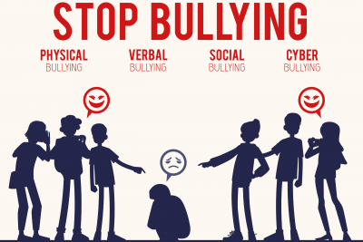
https://wapave.org/bullying-at-school-resources-and-the-rights-of-students-with-special-needs/

Slide 36
Sources
Positive discipline in the inclusive, learning-friendly classroom: a guide for teachers and teacher educators https://unesdoc.unesco.org/ark:/48223/pf0000149284
Disciplining Students With Disabilities (wrightslaw.com)
Nelsen, J., Foster, S., & Raphael, A. (2011). Positive discipline for children with special needs: Raising and teaching all children to become resilient, responsible, and respectful. Harmony.
Positively effective discipline for special needs kids
https://www.newyorkfamily.com/positively-effective-discipline-for-special-needs-kids/
Disciplining Your Child With Special Needs https://www.hopkinsallchildrens.org/Patients-Families/Health-Library/HealthDocNew/Disciplining-Your-Child-With-Special-Needs
Positive discipline in the inclusive, learning-friendly classroom: a guide for teachers and teacher educators - UNESCO Digital Library
11 Classroom Management Strategies for Children with Special Needs (stageslearning.com)
Positive Discipline for Kids with Special Needs | Different Dream Living

Slide 37
Thank you for your attention! ☺ გმადლობთ ყურადღებისთვის
Notes:
37

